Slide 1
“ COP21” Climate Justice Global to Local Perspectives
Notes:
LEED=Leadership for Energy and Environmental Design. Green Infrastructure Building = GIB. CountiesKane, DuPage, Kendall,Will

Slide 2
Climate Justice
Preventable Deaths and Illnesses Due to Heat Island Effects & Climate Change (floods, tornadoes, etc.from…
Full and equally protective environmental landscapes

Slide 3
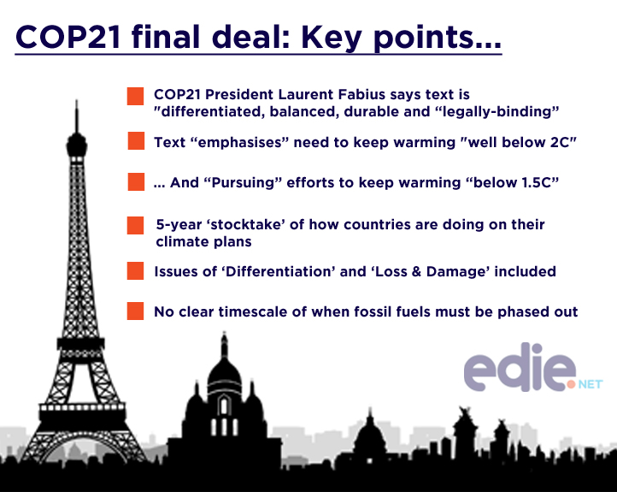

Slide 4
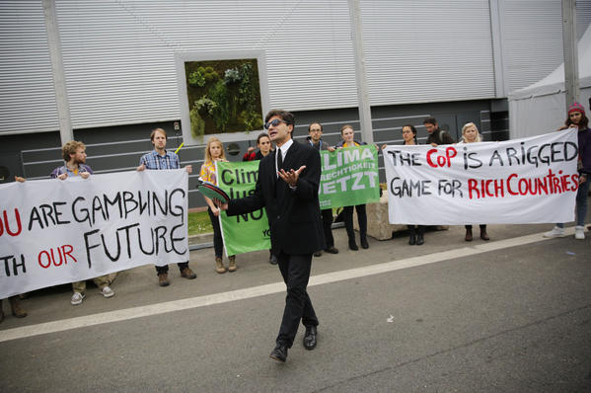

Slide 5
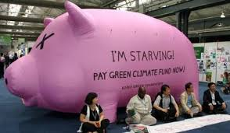

Slide 6
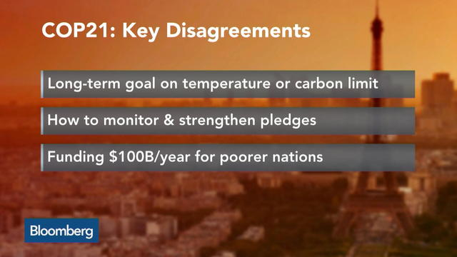

Slide 7
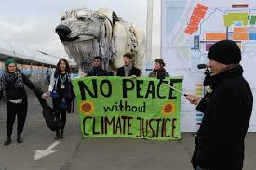

Slide 8
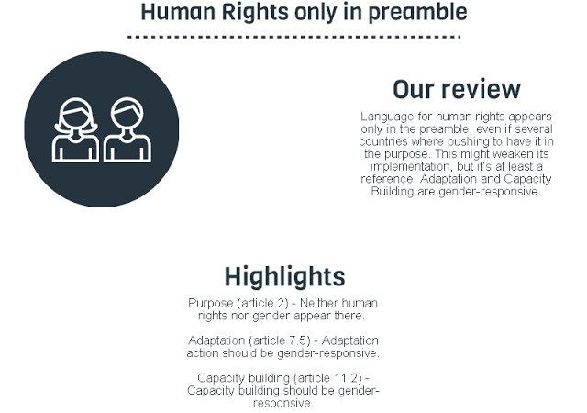

Slide 9
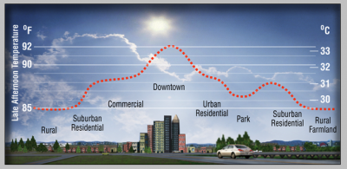
Heat Island Effect
Notes:
The use of dark , non-reflective surfaces for roofs , parking and walkways contribute to heat island effect by absorbing sun’s rays and then radiating this energy back into the environment. Causing an elevation of between 2 to 4 degrees Fahrenheit compared to suburban and rural areas.

Slide 10
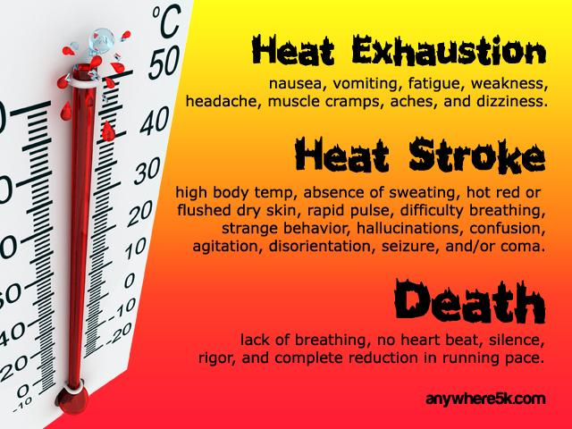

Heat Island Effect So Why Should We Care?
Cardiovascular Disease
Diabetes
Metabolic Syndrome
Asthma
Notes:
The body’s ability to deal with increase heat is drastically impaired by these individuals. Their bodies must work harder (the heart) leading to heal stroke and eventually death. Chicago in 1995 had over 500 deaths. Over 3200 deaths were due to heat according to the CDC between 1993 and 2003 with cardiovascular disease representing over 55% of the deaths. Heat stroke occurs when the body’s temperature exceeds 106 F or 41 C. Other heat illnesses includes heat rash, heat edema and heat cramps.

Slide 11
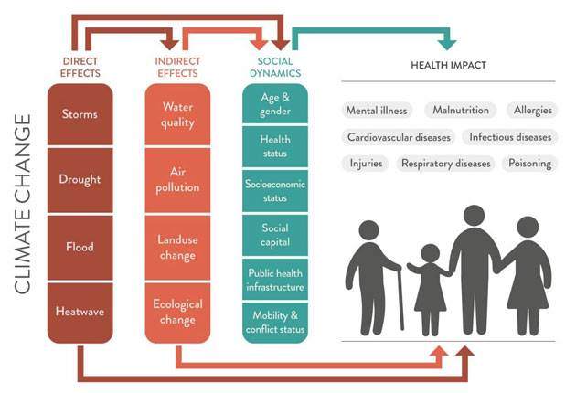

Slide 12
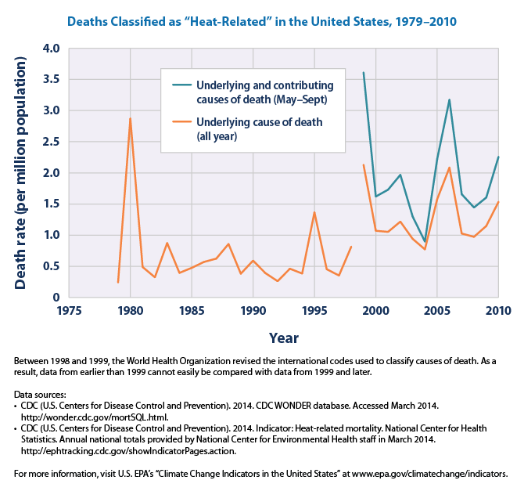

Slide 13
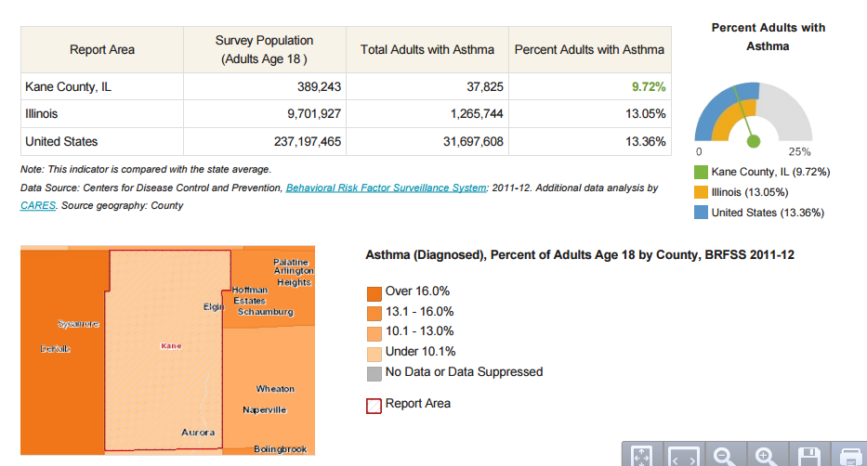

Slide 14
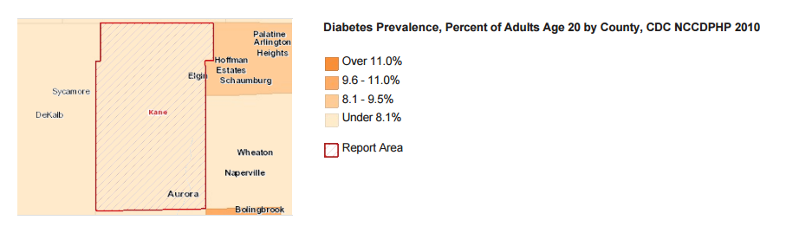

Slide 15
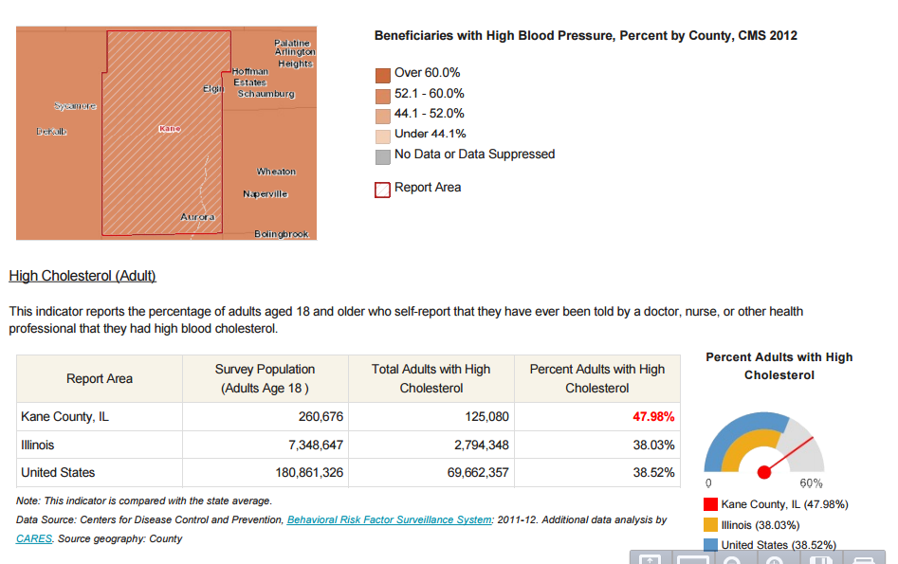

Slide 16
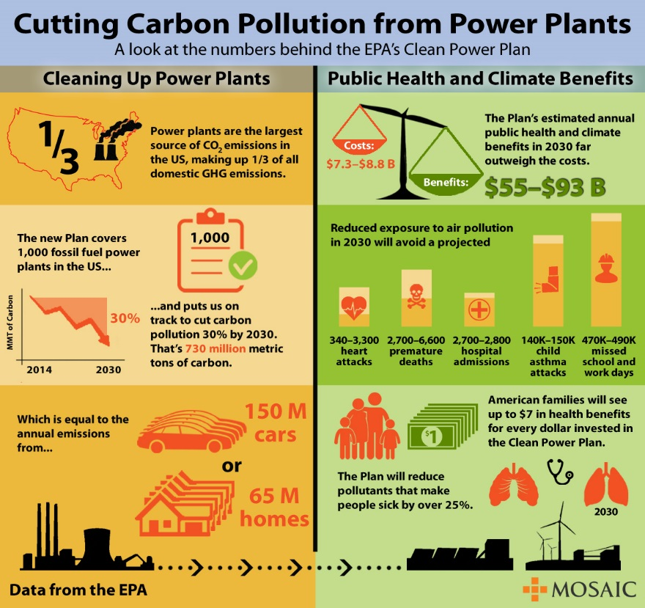

Slide 17
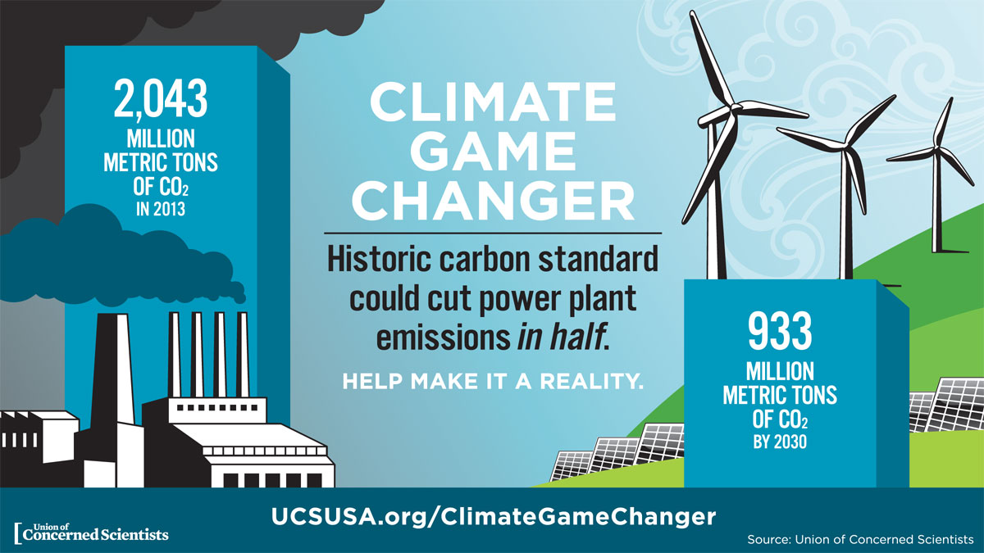

Slide 18
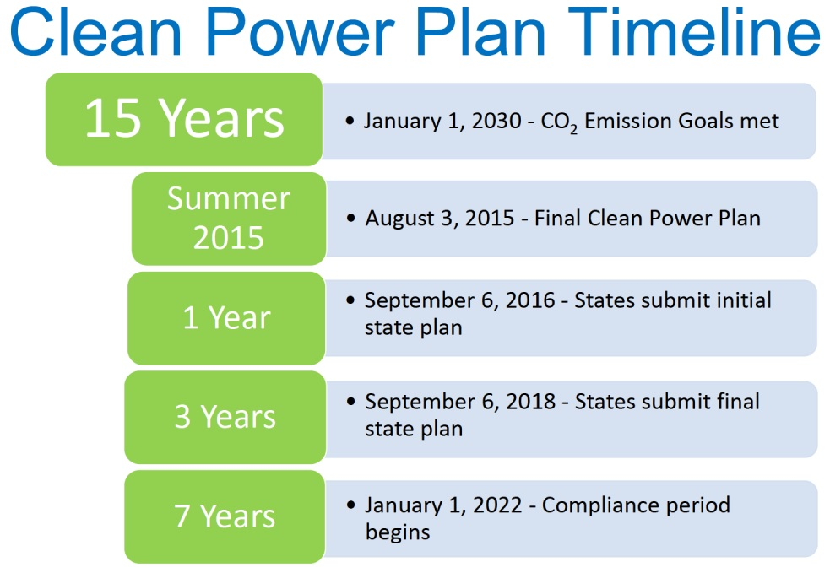

Slide 19
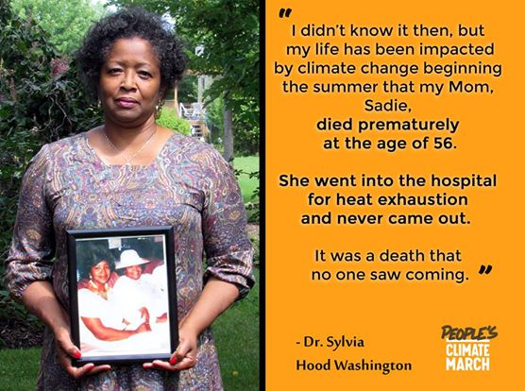
Why Do I Care?
Notes:
Nurse, Community Activist, Urban Conservationist, Active Environmentalist who worked with Mayors/State Representatives in the 1960s through the 1970s to bring trees and parks to her community in Ohio.

Slide 20
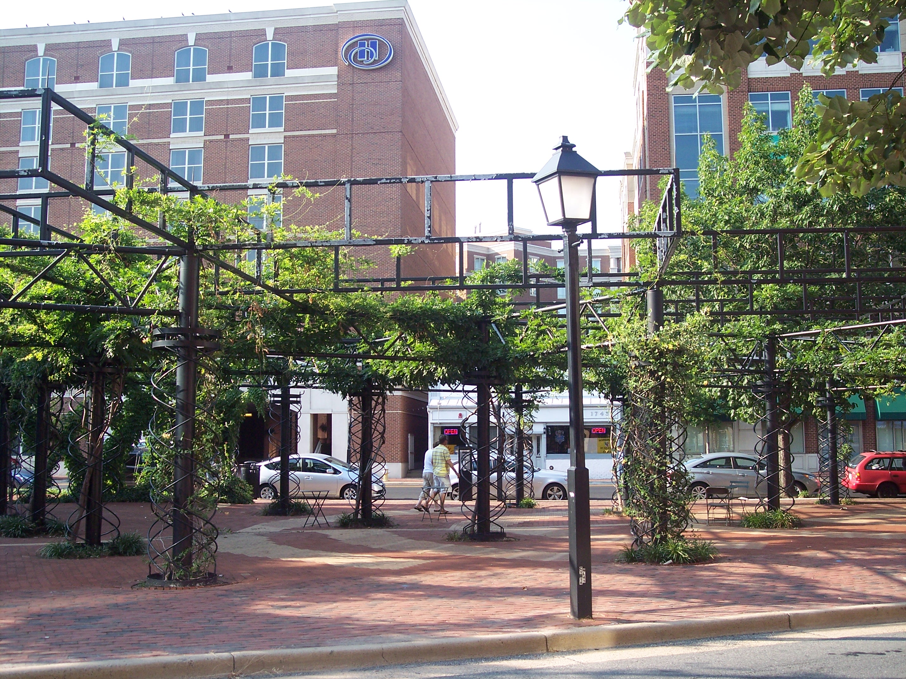
Shade from Open Structures (SRI>29)
Canopied Walkways
Vine Pergolas

